Slide 1

Securithm Investor Pitch Deck
AI-powered smart contract security for faster, safer Web3 deployment
8/9/2026
Shivam & Satyam

Slide 2
Agenda
Problem and Solution
Market and Business
Go To Market and Roadmap
Page 02

Slide 3
Problem and Solution
Page 03

Slide 4

Why Securithm Matters
Problem and Solution
Prevent losses before launch
Securithm surfaces smart contract risks before code reaches mainnet.
Security built into shipping
Developer-friendly workflows make checks part of everyday development.
Faster, cheaper, higher trust
Cut delays and audit burden while strengthening on-chain confidence.
Page 04

Slide 5



The Security Gap
Problem and Solution
Exploits are still winning
Contract bugs keep turning into real losses across Web3.
Every incident erodes user trust and raises launch risk.
Audits arrive too late
Manual reviews take weeks and stall critical shipping timelines.
High cost forces teams to audit less, or only once.
No continuous feedback loop
Developers lack fast signals while writing and changing code.
Security becomes a last-step gate, not a daily workflow.
Page 05

Slide 6

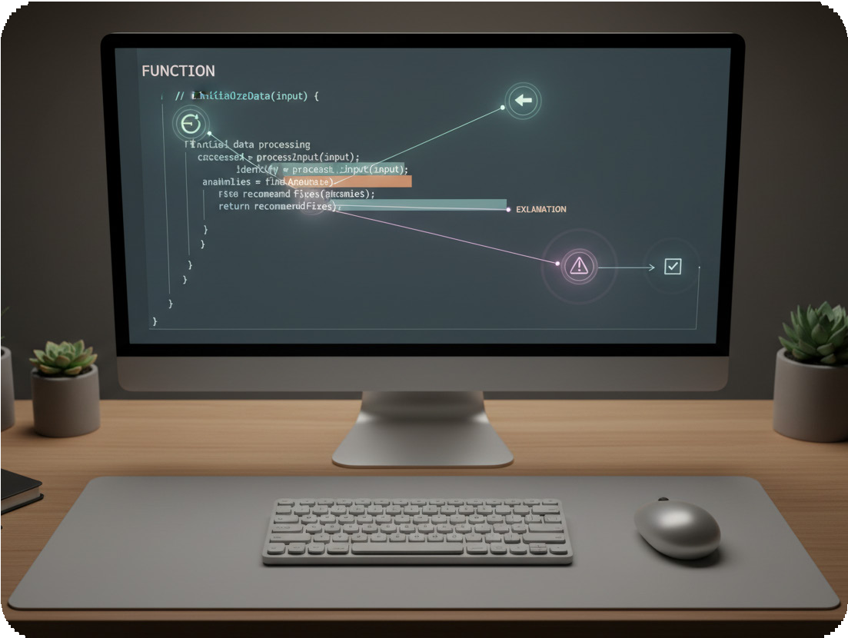
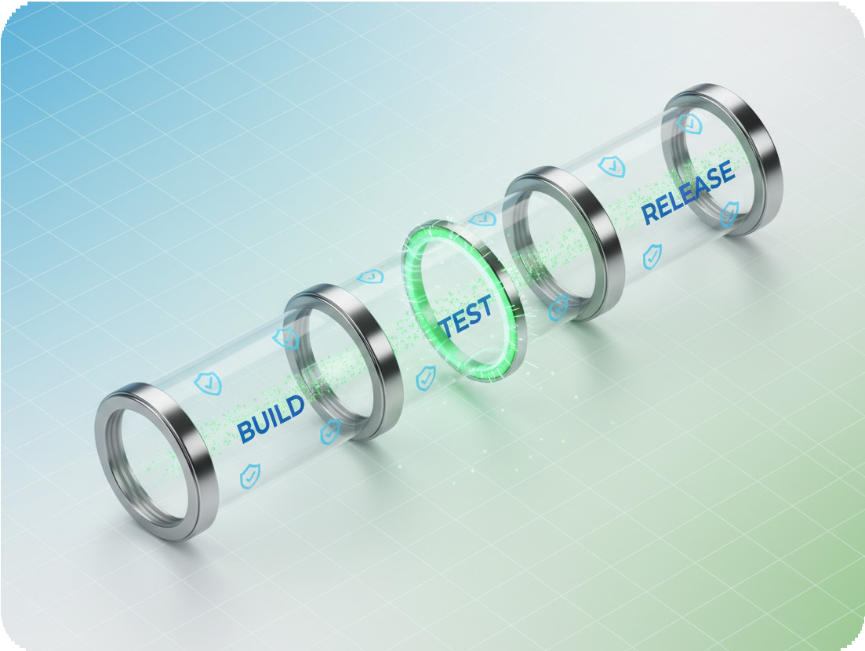
Rapid risk detection
Problem and Solution
Scan a contract in minutes and surface likely vulnerabilities early.
Prioritize findings with clear severity so teams act fast.
Our Solution
Actionable developer guidance
Get fix-focused explanations that map issues to next steps.
Reduce back-and-forth by shipping changes with confidence.
From audits to workflow
Make security a continuous check during build, test, and release.
Catch problems before deployment to avoid expensive late-stage surprises.
Page 06

Slide 7
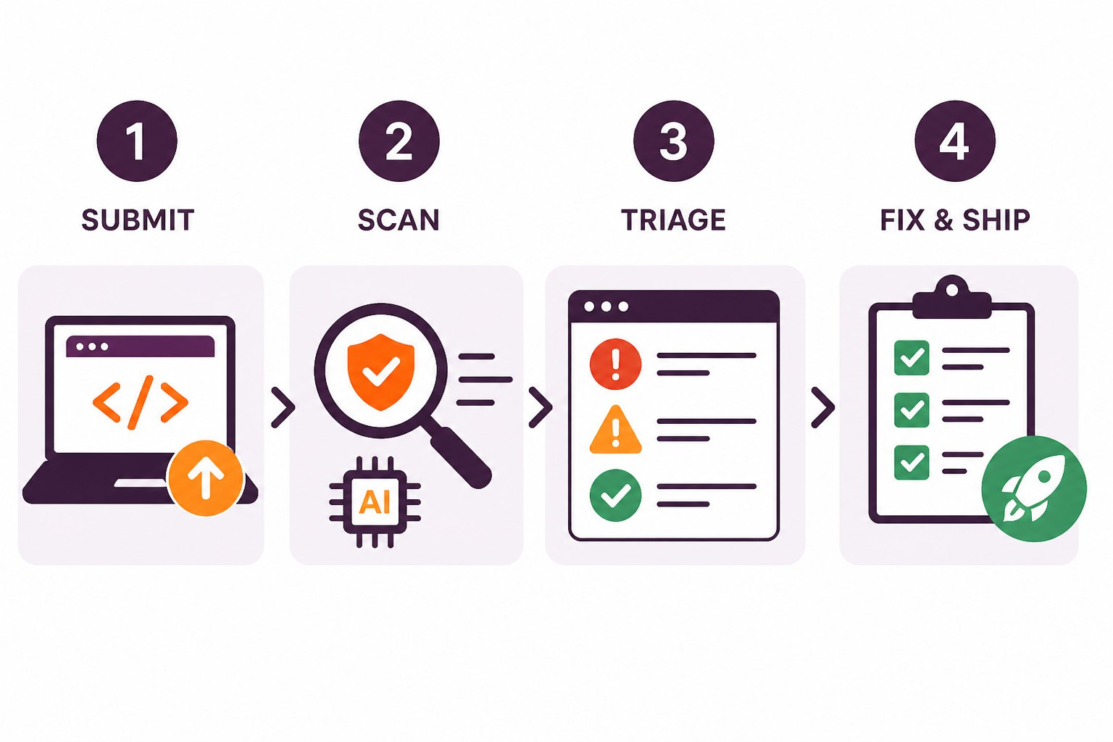
How It Works
Problem and Solution
Submit
Upload or paste a smart contract directly in Securithm.
Scan
Automated checks run fast, with AI review for context.
Triage
Dashboard groups findings by severity, with clear explanations.
Fix and ship
Suggested next steps help teams resolve issues pre-deploy.
Page 07

Slide 8
Market and Business
Page 08

Slide 9
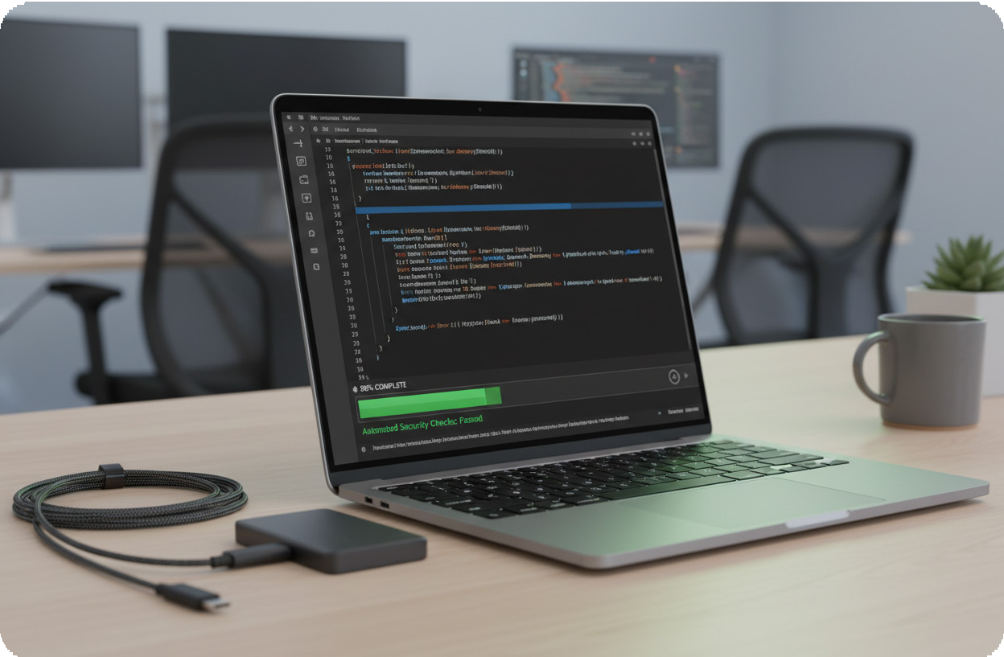


Why Teams Choose Us
Market and Business
01
02
03
Ship faster with confidence
Get security feedback early, not weeks later after a manual audit.
Catch issues before deployment, reducing costly rework and delays.
Built for real teams and budgets
Designed to be accessible for indie builders and growing protocols.
Scale up coverage as usage grows, without adding heavy overhead.
Fits your developer workflow
Integrates into everyday build and release cycles instead of blocking them.
Turns findings into clear next steps developers can act on quickly.
Page 09

Slide 10



Market Opportunity
Market and Business
A growing security spend
Web3 keeps expanding, and security is becoming non-negotiable infrastructure.
Each new protocol increases risk exposure and demand for earlier checks.
Beachhead ecosystems first
Start where most contracts ship: Ethereum, Solana, and major Layer 2s.
Focus on the developer workflows that ship fast and break often.
Regulation drives adoption
Stronger oversight pushes teams to prove security before launch.
Institutional capital raises expectations for audit-grade assurance.

Slide 11
Business Model
Revenue stream | Who it serves | How it charges | Why it fits
SaaS subscriptions | Indie devs and teams | Monthly or annual tiers | Predictable recurring revenue
Pay-per-scan | Flexible or infrequent users | Fee per contract scan | Low-friction usage start
Enterprise plans | Protocols and large orgs | Custom contract and invoicing | Deeper workflow support

Slide 12



Incumbents today
Market and Business
Teams choose CertiK, ConsenSys Diligence, and Hacken for audits.
Developers use Slither and Mythril for fast, tool-based checks.
Competitive
Landscape
Where Securithm wins
Deliver automated findings quickly, without long audit cycles.
Keep the workflow developer-friendly, clear, and easy to act on.
Investor takeaway
Make security analysis more scalable and accessible for more teams.
Lower cost to secure releases, while improving overall on-chain trust.
Page 12

Slide 13
Go To Market and Roadmap
Page 13

Slide 14


Go To Market
Go To Market and Roadmap
01
02
03
Meet developers where they build
Ship integrations for VS Code and common build pipelines.
Make scans a default step before testnet and mainnet releases.
Ecosystem partnerships
Work with L1/L2 foundations to support grantees and accelerators.
Co-market security workflows with protocol teams and tooling partners.
Community-led adoption
Sponsor hackathons and run security clinics for builder communities.
Turn early users into advocates with templates and shareable reports.
Page 14

Slide 15
Traction Roadmap Ask
Go To Market and Roadmap
6-12 months: Platform expansion
Next: Workflow integrations
Raise: Under
$250k pre-seed
Today: Live MVP
Use of funds
Vercel MVP live for early validation
Plug into dev workflows and release cycles
Launch API and broaden chain support
SAFE round to fund product and GTM
50% Eng, 30% GTM,
20% Audits/Legal
Page 15

